Slide 1

Memory – information and strategies
Stratford School
Information for Pupils
10.05.23
SEND supported
Notes:
LTM can be used to compensate

Slide 2


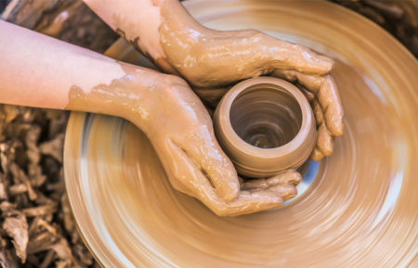
How do you remember?
SEND supported
This Photo by Unknown Author is licensed under CC BY
Notes:
LTM can be used to compensate

Slide 3
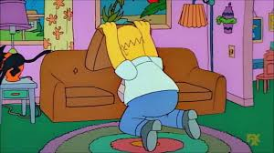
Short Term Verbal Memory
This is your memory of what you have heard
It only lasts for a few seconds
If you don’t do something about it, it is gone and you can’t get it back
It will be harder to learn sequences such as times tables, the alphabet, spellings
It will be harder to remember instructions and explanations
It will be harder to copy from the board
There are likely to be difficulties with organisation; things will be easily lost, homework forgotten
SEND supported
Notes:
Do telephone number 07842 637491
Average adult – 7 items

Slide 4
Activity:
Remembering a list of spoken items.

Slide 5
Short Term Visual Memory
This is your memory of what you have seen (shape, orientation, other visual features and patterns of movement)
It only lasts for a few seconds
If you don’t do something about it, it is gone and you can’t get it back
It will be harder to recall spellings, and words when reading.
You might not realise that spellings are not correct.
It will be harder to copy information from the board or from a book.
You may not remember some in maths.
SEND supported
Notes:
Do telephone number 07842 637491
Average adult – 7 items

Slide 6



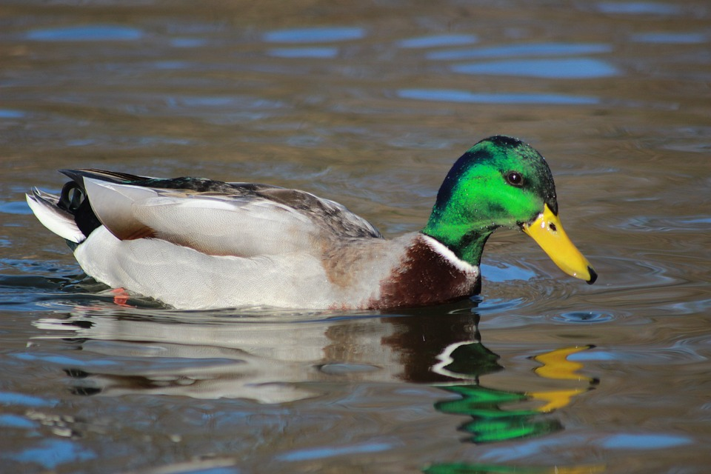

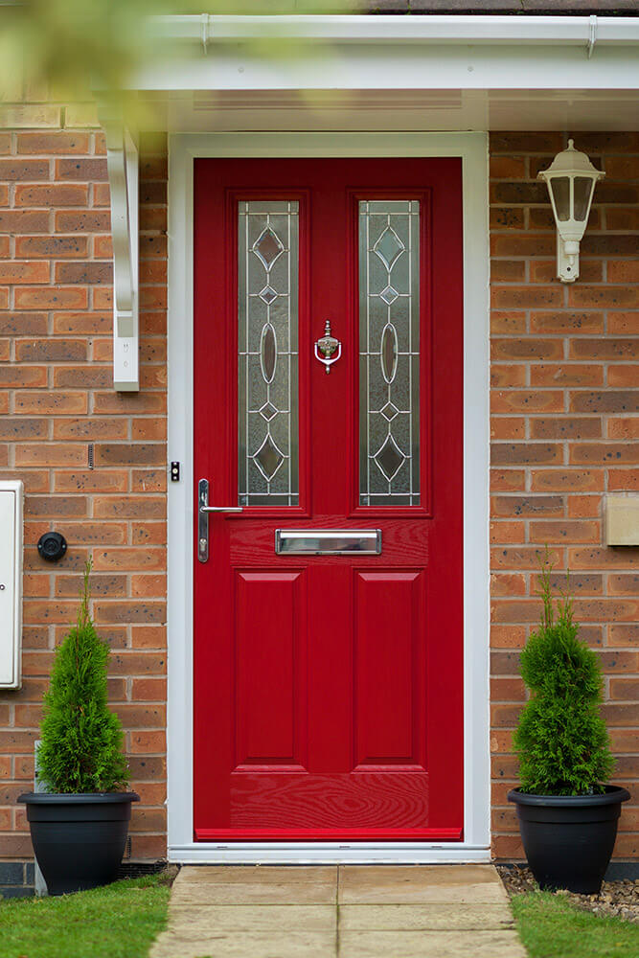
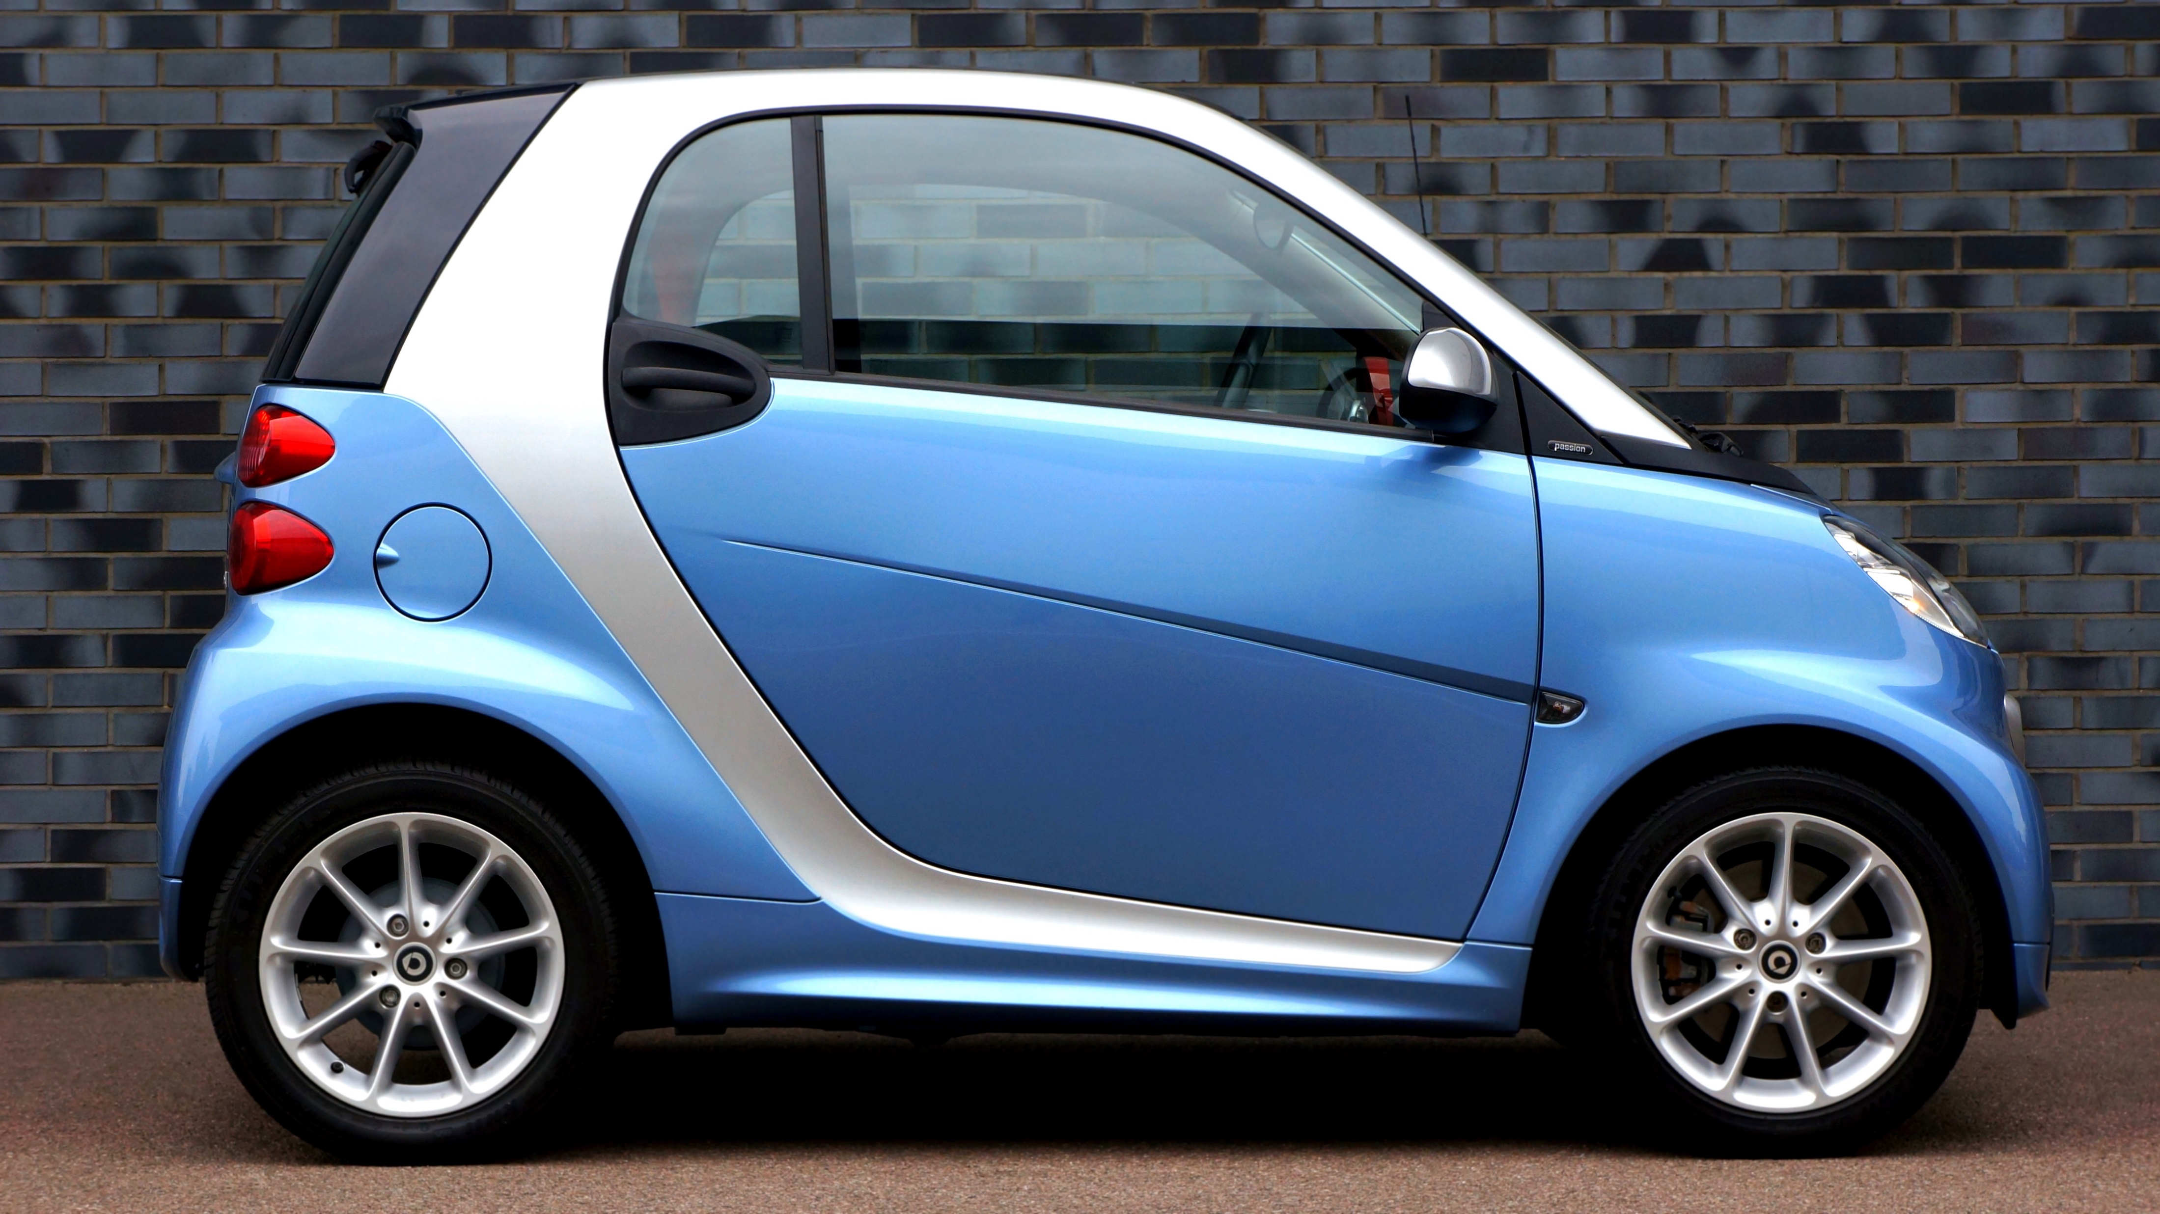
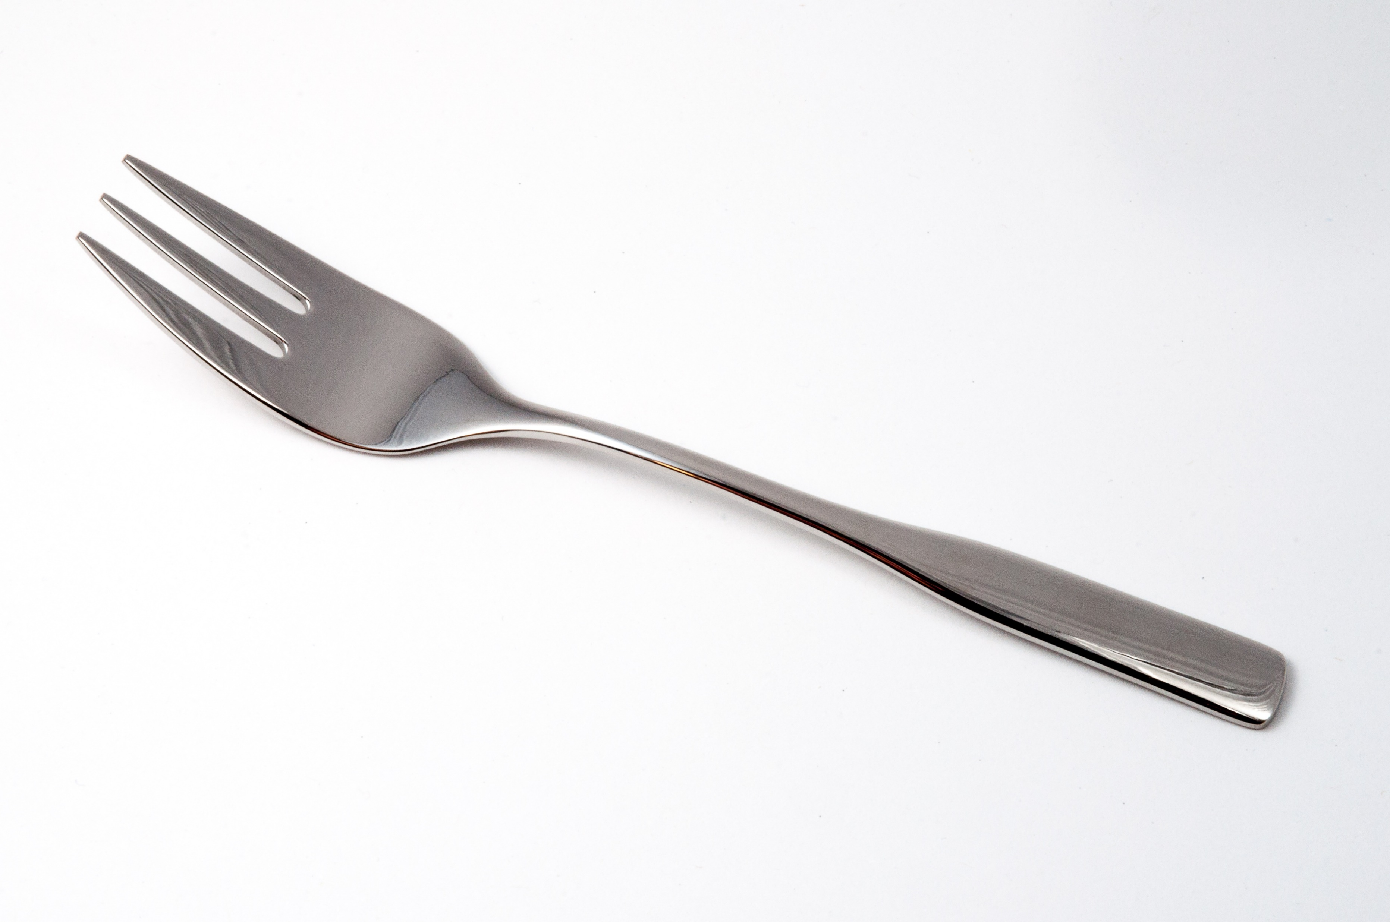


Activity:
Remembering visual items.
This Photo by Unknown Author is licensed under CC BY-SA

Slide 7
Activity:
Remembering visual items.
This Photo by Unknown Author is licensed under CC BY-SA

Slide 9
Activity:
Remembering visual items.
This Photo by Unknown Author is licensed under CC BY-SA

Slide 10
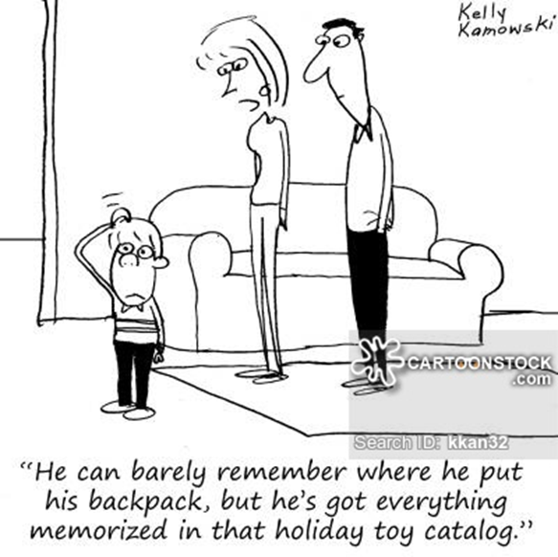
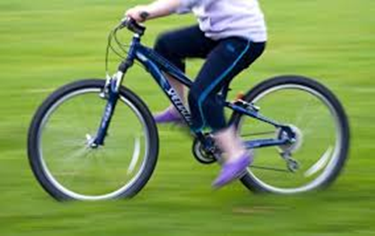
USE LONG TERM MEMORY:
Semantic memory
Stored knowledge about the world – particularly
what we are interested in
New information is related to what we already have stored in semantic memory
Procedural memory
Lots of practice
Difficult to explain process easily
Stable
SEND supported
Notes:
CC discuss

Slide 11
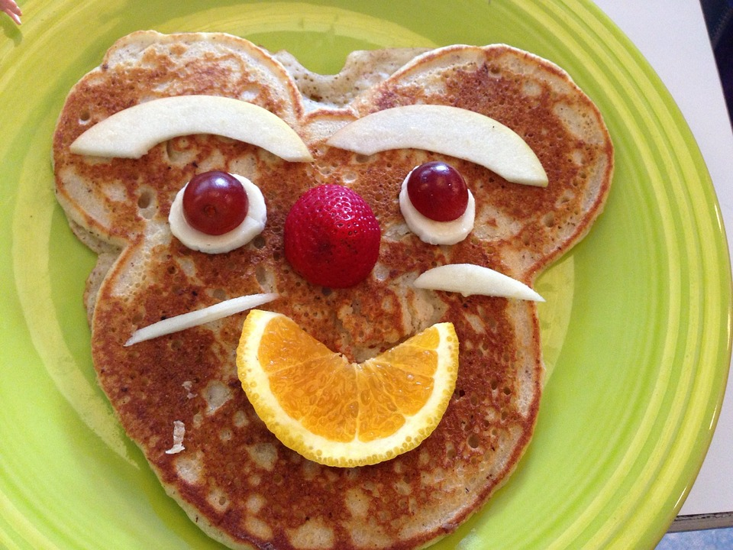
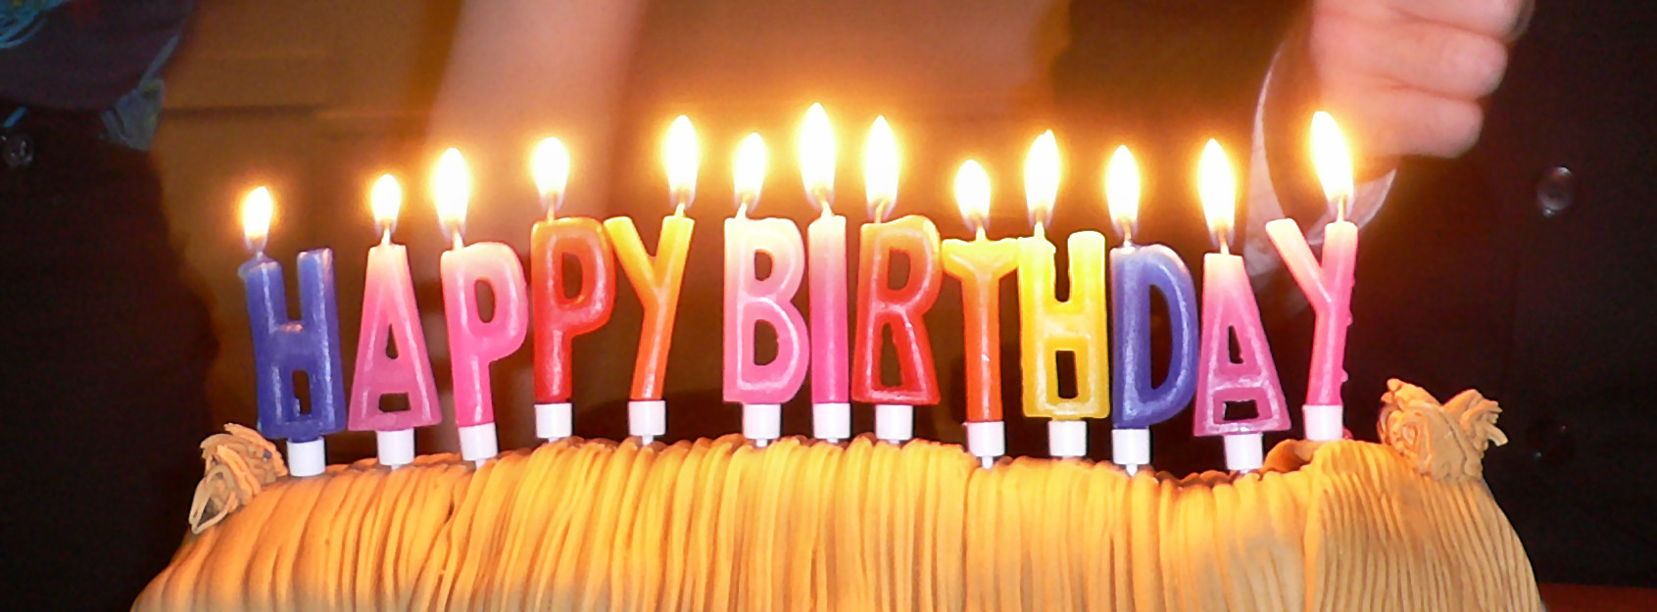
USE LONG TERM MEMORY:
Episodic Memory
Routine, everyday information
Specific events in recent past – minutes, hours, days
Fade rapidly unless they are unusual and become more autobiographical
Autobiographical Memory
Personal facts – information about family and friends, where we have lived, the school we went to etc
Significant events (usually emotional)
Often reflected upon and discussed
SEND supported
Notes:
CC discuss

Slide 12

Memory Strategies
Rehearsal / Repetition (saying over and over again
Chunking (putting facts in groups)
Rhyme/rhythm/rap/song
Use technology eg reminders and alerts on phone
Words in different colours/fonts
Attach a visual, concrete image to abstract concepts
Visualisation – objects in a room (sequences)
SEND supported

Slide 13
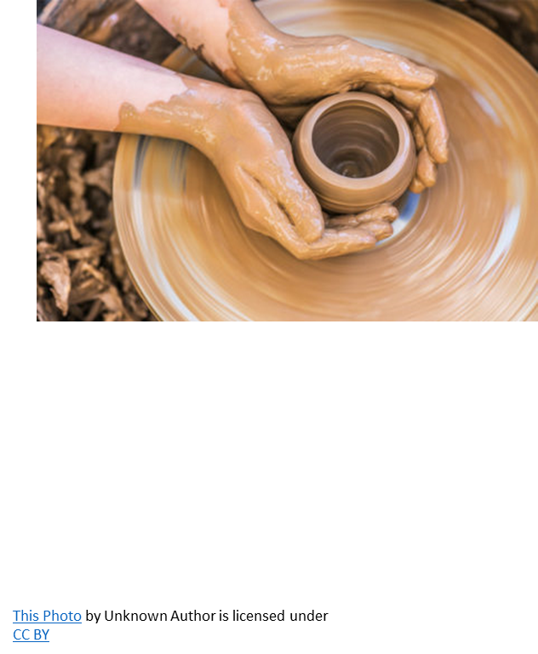
Memory Strategies
Visualisation – picture yourself doing something or act it out
Memory Pegs
Make up a silly story
Memory palace – use all the senses
Go for a walk while listening to revision notes
SEND supported

Slide 14






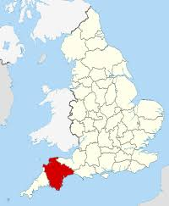

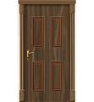
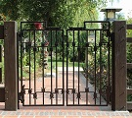
The Number-Rhyme Peg system is perhaps the easiest peg memory system to learn. For each of the numbers from 1 to 10 (and even up to 20) you associate with each number a word that rhymes with that number. Most people find this very easy to do.
Here is a version of the number-rhyme list.
1 Sun 5 Hive 9 Line
2 Shoe 6 Sticks 10 Hen
3 Tree 7 Devon
4 Door 8 Gate

