Slide 1
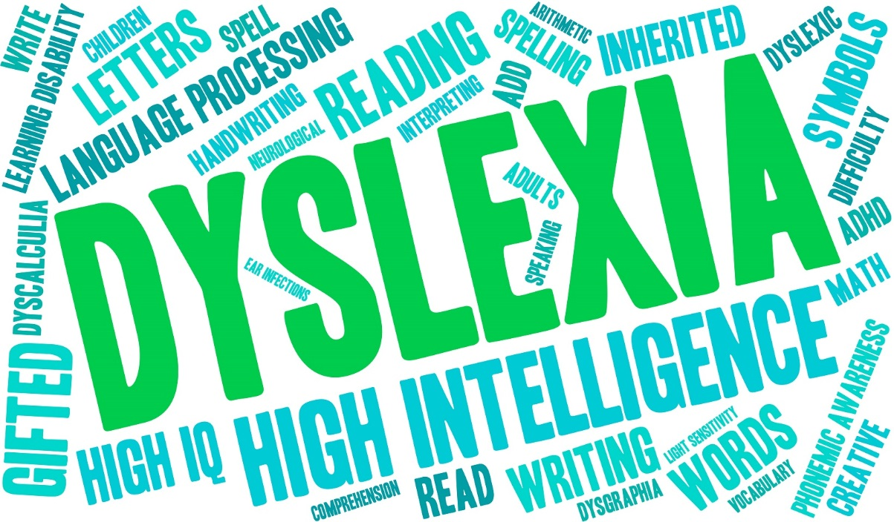

Slide 2
'Dyslexia is a learning difficulty that primarily affects the skills involved in accurate and fluent word reading and spelling.
Characteristic features of dyslexia are difficulties in phonological awareness, verbal memory and verbal processing speed.
A good indication of the severity and persistence of dyslexic difficulties can be gained by examining how the individual responds or has responded to well founded intervention.'
British Dyslexia Association, 2009

Slide 3

Weaknesses
Dyslexia is really about information processing: dyslexic people may have difficulty processing and remembering information they see and hear. This can affect learning and the acquisition of literacy skills.
Spelling
Punctuation
Reading
Processing and retaining written instruction

Slide 4

Strengths
On the plus side, dyslexic people often have strong visual, creative and problem solving skills and are prominent among entrepreneurs, inventors, architects, engineers and in the arts and entertainment world.
Dyslexic people are associated with holistic thinking (looking at the bigger picture).
Many famous and successful people are dyslexic.

Slide 5
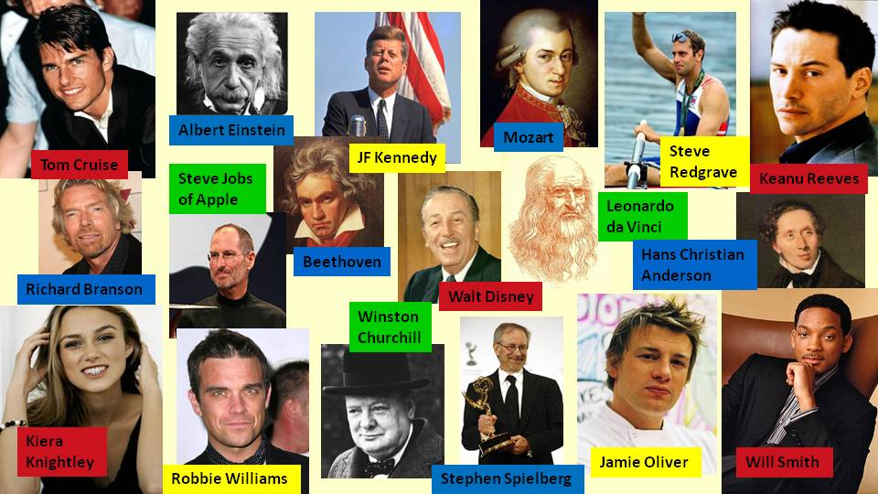

Slide 6
How it feels to be dyslexic
‘I see things from a different perspective.’
‘I can come up with solutions no one else has thought of and I think fast on my feet.’
‘When I am reading, occasionally a passage will get all jumbled up, but when it happens I have to read and re-read the passage over again.
‘I know what I want to say, but I can never find the right words.’
‘In formal situations, although I know what I want to say, I struggle, lose focus and then my mind goes blank and I panic.'
‘I have the right ideas, but I can’t get them down on paper.’
‘It’s like my computer crashing with too much information!’
‘Sometimes when I am being told what to do, the words I hear get all jumbled up in my mind and I just can’t take in what is being said to me.’
‘In general conversation with family, friends and colleagues they usually accept that I tend to ramble, forget and repeat,…. because that’s part of me’.

Slide 7
Common Misconceptions
Myth #1: It’s a boy thing..
Fact: Boys with dyslexia are more frequently identified in schools. But dyslexia affects both genders in nearly equal numbers. So what explains the difference in schools? Researchers found that girls tend to quietly muddle through challenges while boys become more rambunctious. Boys’ behavioral difficulties draw the teacher’s attention to them.
Myth #2: People with dyslexia read backwards, that’s all.
Fact: Dyslexia makes it challenging to break down words. Symptoms sometimes include flipping letters around. But reversing letters isn’t always a sign of dyslexia. (Young kids who don’t have dyslexia often do this too.) Nor is it the only problem associated with it. People with dyslexia may have trouble with a number of skills, including writing, spelling, speaking and socialising.
Myth #3: People with dyslexia just need to try harder.
Fact: The brain functions differently in people with dyslexia. Some traditional reading and language instruction may not work for them. Studies have shown people with dyslexia get the most benefit from intensive instruction or tutoring that’s highly structured. Some methods involve all learning pathways in the brain, including sight, sound and touch.

Slide 8
Common Misconceptions
Myth #4: Dyslexia is a sign of low IQ.
Fact: Dyslexia is not a sign of low intelligence. It occurs in children of all backgrounds and intelligence levels. Having dyslexia certainly doesn’t mean your child isn’t smart. With the right support, many children with dyslexia go on to higher education and are very successful in their careers.
Myth #5: Dyslexia is curable.
Fact: Dyslexia is a brain-based condition and a lifelong challenge. But early intervention and helpful classroom accommodations can have a significant, positive impact on reading ability and academic achievement.

Slide 9

Strategies
4. Don’t use the word ‘lazy’
People with dyslexia have to work harder to produce a smaller amount.
They will have difficulty staying focused when reading, writing or listening.
1. Praise Gives Power Criticism Kills
A person with dyslexia needs a boost to their self-confidence before they can learn to overcome their difficulties. They have already experienced failure and deep down they often don’t believe they are capable of learning.
To re-establish self-confidence provide the opportunity to succeed and give praise for small achievements. Mark sensitively and use positive reinforcement.
5. Expect less written work
A person with dyslexia may be verbally bright but struggle to put ideas into writing.
Allow more time for reading, listening and understanding.
6. Prepare a printout of homework and stick it in their book
Provide numbered steps, e.g. 1. Do this. 2. Do that etc.
2. Don’t ask person with dyslexia to read aloud
Words are likely to be misread or skipped, causing embarrassment.
7. Do not ask them to copy text from a board or book
Give a printout. Suggest they highlight key areas and draw thumbnail pictures in the margin to represent the most important points.
3. Don’t automatically give punishment for forgetting books or sports kit
Offer positive strategies such as having one place to put things away.
8. Discuss an activity to make sure it is understood
Visualising the activity or linking it to a funny action may help someone with dyslexia remember.

Slide 10

A Dyslexia-Friendly Environment
A well organised environment with clear routines to minimise movement
and noise.
A good mix of Visual, Auditory and Kinaesthetic activities within each
lesson.
Dyslexic pupils sitting within easy eye contact of the teacher.
Revisiting reading and spelling strategies at the start of each year and
having these displayed for constant reference.
Whiteboards with coloured markers to practise spellings and sentences.
Using planning boards or writing frames.
“ If they don’t learn the way we teach them, can
we teach them the way they learn?”
(Dr Harry Chasty)
Using ICT as a multi-sensory method of working.
Giving children thinking and talking time.
Using ‘buddies’ or ‘peer mentors’ to help with homework / organising.
Colour photocopies / coloured wallets for use with white paper.

