Slide 1
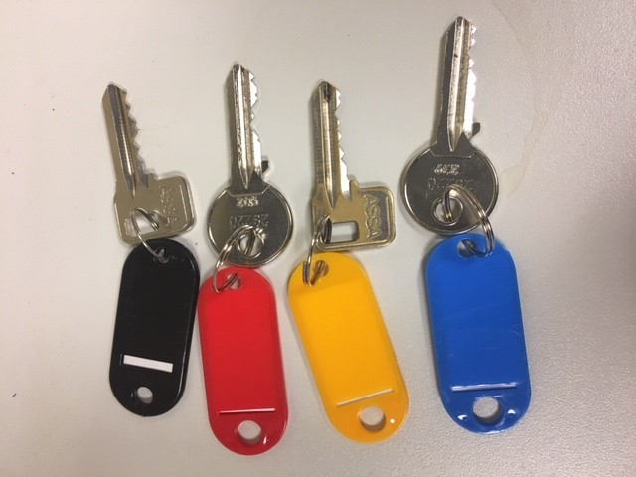
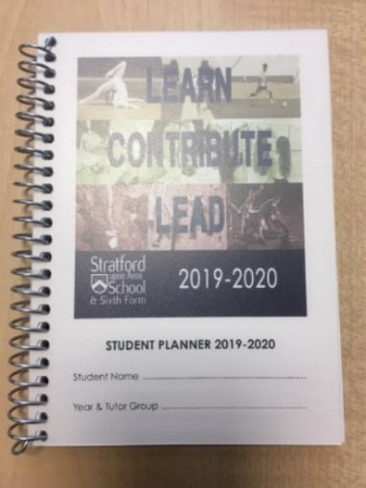
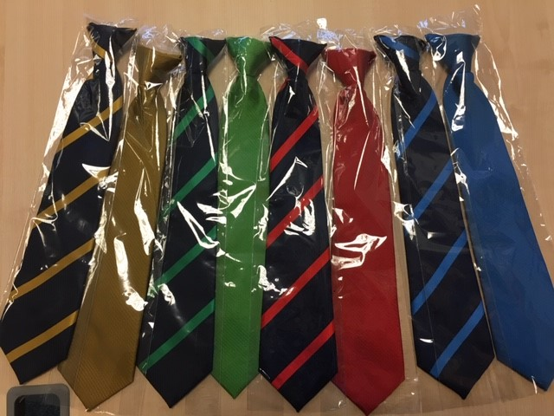
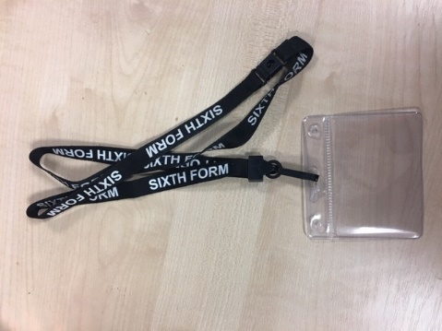
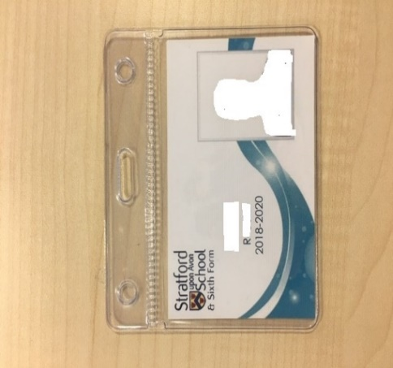
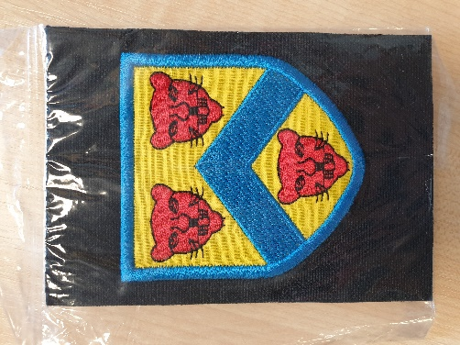
ASR: PRICE LIST
LOCKER KEY: £7.50
PLANNER: £3.00
TIES: £5.50
SIXTH FORM LANYARD: £3.00
POUCH: £1.50
LANYARD £1.50
BADGE: £4.00

